Slide 1


Features for Textual Data
苏佳林，王子禛

Slide 2


特征提取
1
机器学习模型以向量x作为输入，默认x已知
实际解决问题时，x需要由文本数据得到
特征函数
文本数据
向量x
特征提取
（特征表示）

Slide 3
分类问题的类型
2
根据被分类的对象，可以将分类问题分为以下几种：
  word
    one single word
    e.g. “dog”——“does it donate a living thing?”
  texts
    a piece of text(phrase, sentence, paragraph, document)
    e.g. “is it about politics or sports?”
  paired texts
    a pair of words or longer texts
    e.g. “are word A and B synonyms?” “are document A and B written by the same author?”
  word in context
    a piece of text & a particular word within it
    e.g. “book”——“I want to book a flight”
  relation between two words
    two words or phrases within the context of a larger document
    e.g. “does the purchase relation hold between word A and B?”

Slide 4
NLP问题中常用的特征
3
Features for Single Words
  inside information: letters comprising the word and their order , the length of the word, orthographic shape, prefixes and suffixes of the word
  external information:
    Lemmas and Stems
      lemma：构词法，book, booking——book
      stem：单纯截取词中的字母序列，picture, pictured——pictur
    Lexical Resources
      词典性质的资源，如 WordNet、FrameNet、VerbNet等。
      虽然能提供孤立词的很多相关信息，但具体使用通常是针对具体任务的，通常要求大量细致的工程操作，实际上目前在 NN 中用的很少。
    Distributional Information

Slide 5


NLP问题中常用的特征
4
Features for Text
  counts and order of the letter and words within the context
  Bag of words(BOW)
    注意还有 bag-of-letter-bigrams 等特殊BOW。
  Weighting
    通常结合 TF、TF-IDF 等
    TF：
    TF-IDF：

Slide 6

NLP问题中常用的特征
5
Features of Words in Context
  the position of the word within the sentence, the words or letters surrounding it
  Windows：
    e.g. “the brown fox jumped over the lazy dog”
  Position：
    更关注单词在句子中的绝对位置信息

Slide 7
NLP问题中常用的特征
6
Features for Word Relations in Context
  two words in the context
  position of each word
  the words surrounding them
  distance between the words
  the identities of the words that appear between them

Slide 8
Inferred Linguistic Properties
7
Sentences in natural language have structures beyond the linear order of their words. The structure follows an intricate set of rules that are not directly observable to us.
word classes (part-of-speech tags)
morphology
syntax
semantic
etc.
Notes:
Intricate 复杂的
词性，词形，语法，语义

Slide 9
Linguistic Annotation
8
the boy with the black shirt opened the door with a key
the boy with the black shirt opened
Det Noun Prep Det Adj Noun Verb
the door with a key
Det Noun Prep Det Noun
Notes:
词性标注 pos-of-speech

Slide 10
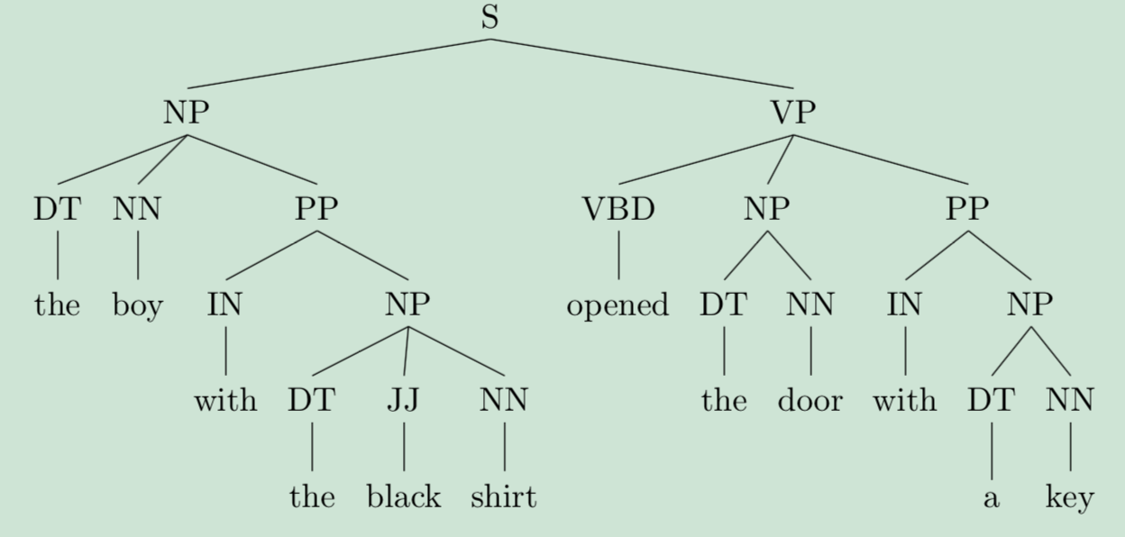
Linguistic Annotation
9
the boy with the black shirt opened the door with a key
[_{NP}the boy] [_{PP}with] [_{NP}the black shirt] [_{VP}opened] [_{NP}the door] [_{PP}with] [_{NP}a key]
Notes:
语法块 syntactic chunk
语法树 phrase-structure tree/ constituency tree

Slide 11
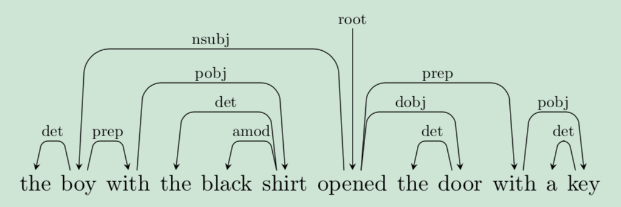
Linguistic Annotation
1
the boy with the black shirt opened the door with a key
Under dependency syntax, each word in the sentence is a modifier of another word, which is called its head. Each word in the sentence has a head, except for the main word, usually a verb, which is the root.
Notes:
依存树 dependency tree
尽管语法树可以准确的把单词组合成短语，但是依存树提供了精确的指向和连接关系，距离较远的单词也可以在依存树中有较近的距离，如boy-opened，有4个单词的距离，但是有一条直连的边
While constituency trees make explicit the grouping of words into phrases, dependency trees make explicit the modification relations and connections between words. Words that are far apart in the surface form of the sentence may be close in its dependency tree. For example, boy and opened have 4 words between them in the surface form, but have a direct nsubj edge connecting them in the dependency tree.

Slide 12
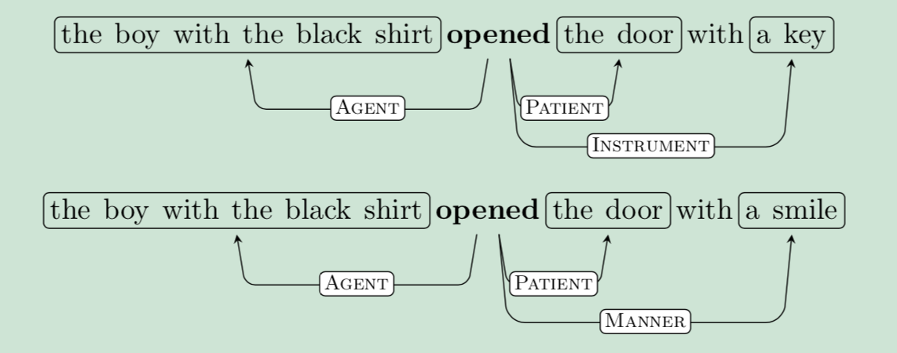
Linguistic Annotation
1
the boy with the black shirt opened the door with a key
Notes:
语义角色标注 semantic role labeling（instrument 工具）
一个单词的差别修改了语义角色
Syntactic level 语法树 依存树，更关注句子的结构
Semantic level 语义角色标注

Slide 13
Discourse Relations
1
- Elaboration e.g. moreover
- Contradiction e.g. however
- Cause Effect e.g. and
Notes:
discourse relations 多句间的话语关系
Elaboration 递进

Slide 14
Anaphora
1
The boy opened the door with a key. It₁ wasn’t locked and he₁ entered the room. He₂ saw a man. He₃ was smiling.
Anaphora resolution (also called coreference resolution) will tell us that It₁ refers to the door (and not the key or the boy), he₂ refers to the boy and he₃ is likely to refer to the man.
Notes:
Anaphora 指代
尽管一些预先设定好的规则会过于僵化，但是上述的特征确实可以提取出广泛且重要的特征。有人认为这些特征可以通过网络学习出来，但是这首先需要大量的数据用来训练，此外，假设我们已经获得了充足的数据，我们也希望网络学习指定领域的信息，而不是学习所有领域的信息。

Slide 15
Core Features VS Combination Features
1
Linear models cannot assign a score to a conjunction of events (X occurred and Y occurred and ...) that is not a sum of their individual scores. Thus, when designing features for a linear model, we must define not only the core features but also many combination features.
Neural networks provide non-linear models, and do not suffer from this problem.
Notes:
Conjunction as book-verb-root-position

Slide 16
NGram Features
1
It should be intuitively clear why word-bigrams are more informative than individual words: it captures structures such as New York, not good, and Paris Hilton. Indeed, a bag-of-bigrams representation is much more powerful than bag-of-words, and in many cases proves very hard to beat.
However, it is very hard to know a-priori which ngrams will be useful for a given task. The common solution is to include all ngrams up to a given length, and let the model regularization discard of the less interesting ones by assigning them very low weights.
Ngram features are useful also in the multi-layer perceptron fed with a bag-of-words feature vector of a document. Multi-layer perceptron can infer ngrams when applied to a fixed size windows with positional information, More specialized neural network architectures such as convolutional networks, bidirectional RNNs can be sensitive to informative ngrams of varying lengths.
Notes:
Ngram的优势
计算多种n的取值并赋予不同的权重
不同输入和网络结构考虑是否使用ngram

Slide 17
Distributional Features
1
distributional hypothesis the meaning of a word can be inferred from the
contexts in which it is used
These can be broadly categorized into clustering-based methods, which assign similar words to the same cluster and represent each word by its cluster membership, and to embedding-based methods which represent each word as a vector such that similar words (words having a similar distribution) have similar vectors.

Slide 18
Thanks
1
Notes:
discourse relations 多句间的话语关系
Elaboration 递进

